Slide 1

Duration: 15 Min
Credit: 12
Major Project
SMART STOCK PREDICTOR
Submitted To
Mr. Ravindra Kumar Soni
Professor
Submitted By
Apoorv Raj Dubey
Reg. No.-219310104
School of Computer Science & Engineering
Department of Artificial Intelligence and Machine Learning
Manipal University Jaipur, India
July 2025

Slide 2
Project Introduction – Smart Stock Predictor
The Smart Stock Predictor is a deep learning–powered web application designed to forecast short-term stock price movements by analyzing:
Historical stock data
Technical indicators like SMA, EMA, RSI, MACD, Bollinger Bands, and more
Real-time news sentiment using Natural Language Processing (NLP)
It combines the power of two advanced AI models — LSTM and Transformer — trained on real market data enriched with technical and textual features.
Built with a Django backend and a React frontend, the system delivers:
Accurate AI-based price predictions
Interactive charts and visualizations
Real-time integration with NSE, yFinance, NewsAPI, and GNews

Slide 3
Problem Statement & Motivation
Problem Statement
Traditional stock prediction methods rely solely on historical price data and fail to adapt to market-moving factors like breaking news or public sentiment.
Existing models are slow to react to sudden market changes
They ignore emotional drivers like fear, hype, or social buzz
Most do not combine technical analysis with news-based sentiment
Motivation
To build an intelligent system that captures both quantitative patterns and qualitative context for more accurate and realistic stock predictions.
Integrate deep learning models trained on real-time data
Incorporate news sentiment using NLP
Provide predictions through a user-friendly web interface

Slide 4
Objectives & Goals
Project Objectives
To develop a real-time stock prediction system using advanced deep learning models
To combine technical indicators with news sentiment analysis for context-aware forecasting
To implement and compare the performance of:
LSTM — for learning long-term market trends
Transformer — for capturing complex dependencies and sentiment shifts
To build a scalable, full-stack web application using:
Django (Backend)
React (Frontend)
RESTful APIs for model communication
Enable interactive visualizations of predictions and market trends
Key Goals
Achieve high prediction accuracy using real stock data
Integrate NLP-based sentiment scoring from live news articles
Make the system modular and extensible for future improvements

Slide 5

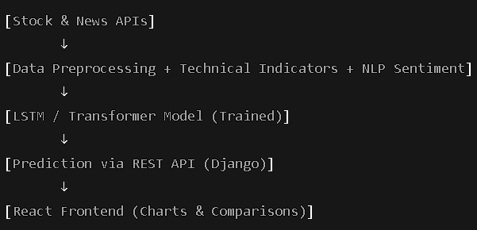
System Architecture
🛠️ Overview
The Smart Stock Predictor follows a modular, full-stack architecture consisting of:
Data Collection Layer
Preprocessing & Feature Engineering Layer
Model Training & Inference Layer
API Layer
Frontend Visualization

Slide 6
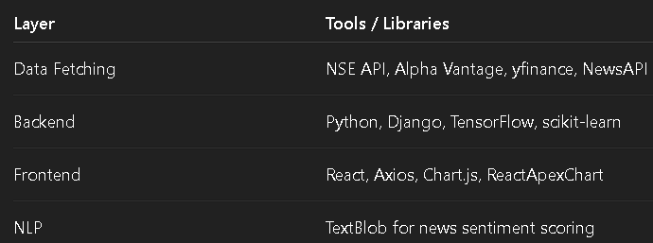
Technologies Used

Slide 7
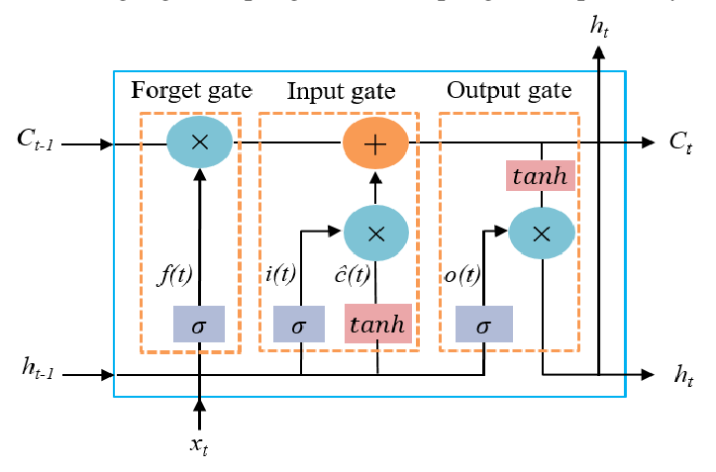
LSTM Model Architecture
What is LSTM?
Long Short-Term Memory (LSTM) is a type of Recurrent Neural Network (RNN) designed to capture long-term dependencies in sequential data — ideal for analyzing stock price trends over time.
Architecture Used in This Project
Input Shape: 60 time steps × 19 features (OHLCV + SMA, EMA, RSI, MACD, Bollinger Bands, ATR + Sentiment)
Model Layers:
2 × LSTM layers (150 units each, with recurrent dropout)
Batch Normalization
Dropout Layer (rate: 0.4)
Dense Output Layer (1 unit for price prediction)
Loss Function: Mean Squared Error (MSE)
Optimizer: Adam
Training Epochs: Up to 100 (with Early Stopping & Learning Rate Scheduling)

Slide 8

Transformer Model Architecture
What is a Transformer?
A Transformer is a deep learning model built on self-attention mechanisms. Unlike LSTM, it processes all time steps in parallel and captures both short- and long-term dependencies without relying on recurrence.
Originally designed for NLP, it has proven highly effective in time-series forecasting, especially when data is affected by external events like news or sentiment shifts.
Architecture Used in This Project
Input Shape: 60 time steps × 19 features (Includes price, volume, indicators & sentiment)
Model Layers:
Dense Layer (projects 19 → 64 dimensions)
Positional Encoding (adds time-step information)
2 × Transformer Encoder Blocks (Each with 4-head self-attention, feed-forward, layer norm, dropout)
Global Average Pooling
Dense Layer (64 units, ReLU)
Dropout Layer (rate: 0.2)
Dense Output Layer (1 unit, linear activation)
Loss Function: MSE
Optimizer: Adam
Training Epochs: Up to 150 (with Early Stopping & LR Reduction)

Slide 9
Data Collection & Preprocessing
Type | Source | Purpose
Stock Prices | NSE API, Alpha Vantage, yfinance | OHLCV data for 21+ days
News Articles | NewsAPI, GNews | Sentiment analysis (NLP)

Slide 10
Fine-Tuning Strategy
Why? Market conditions change quickly. Fine-tuning ensures the model adapts to recent price and sentiment shifts.
How?
Recent data (last 7 days) fetched via fetch_last_60_minutes
Used to update weights with lower learning rate
Avoids retraining from scratch
Retains previously learned patterns
Settings:
Fine-tuning Epochs: 15–20
Learning Rate: 0.0001
Batch Size: 16–32
Training Tools Used
TensorFlow / Keras APIs
Real-time logs of:
Loss curves
Learning rate drops
Validation performance

Slide 11
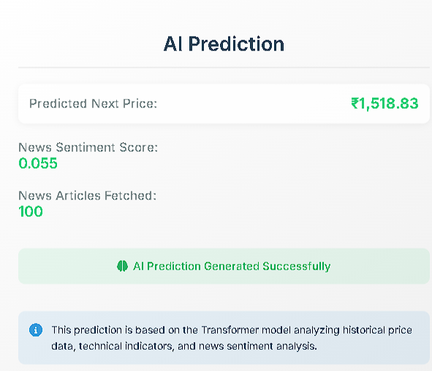
Prediction & Visualization
Prediction Output
User selects a stock (e.g., RELIANCE.NS)
Backend fetches latest stock + news data
Models (LSTM & Transformer) predict the next closing price
Results returned via REST API in JSON format:
json

Slide 12
📈 Results & Analysis
Model | Predicted Price | Actual Price | MSE | RMSE | MAE | R² Score
LSTM | ₹1467.48 | ₹1517.10 | 1067.27 | 32.66 | 28.84 | -0.1383
Transformer | ₹1501.04 | ₹1517.10 | 258.67 | 16.08 | 14.22 | 0.6417

Slide 13
Metric Insights
Transformer performed better overall:
Lower error values (MSE, MAE, RMSE)
More adaptable to real-time sentiment
LSTM lagged slightly behind:
Stronger on long-term trend learning
Less responsive to sudden market shifts
Sentiment Integration Impact
Positive sentiment score (+0.34) boosted prediction accuracy
Transformer dynamically adjusted to news-driven volatility
Sentiment proved to be a key feature in short-term forecasting
Visual Outputs
Line charts: Predicted vs Actual
Radar chart: Metric comparison across models
Dynamic charts rendered using react-chartjs-2

Slide 14
Conclusion & Future Scope
Conclusion
Successfully built a real-time stock prediction system using:
Deep learning models (LSTM and Transformer)
Technical indicators + News sentiment (NLP)
Achieved meaningful prediction accuracy using real data
Integrated predictions into a full-stack app using:
Django (backend)
React (frontend)
REST APIs + Interactive charts
Result: A powerful, AI-based platform for informed stock forecasting

Slide 15
Future Scope
Integrate advanced NLP models (like FinBERT) for deeper sentiment insights
Extend support to multi-stock portfolio prediction
Deploy to cloud platforms for real-time public use
Add confidence intervals and prediction explainability using SHAP/LIME
Build a mobile app version for broader accessibility

